Slide 1


DATA-DRIVEN INSIGHTS AND PREDICTION OF INDIA’S 2024 ELECTIONS
Team Member : Vipul Kumar (Roll no. - 2025MS029)
Timeline : october 2025-december 2025
Program: MS (AI-DS), Department of Engineering Sciences
Course Instructor: Dr. Yashwant Singh Patel

Slide 2

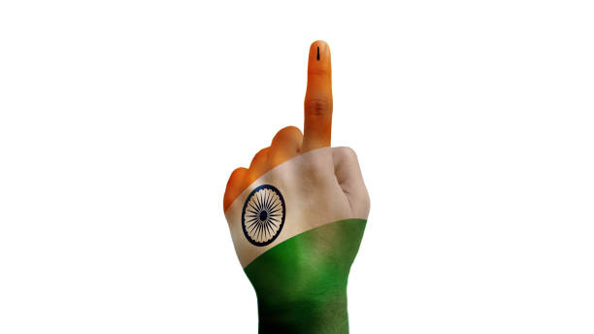
Problem Statement
World's largest democracy challenge - Understanding voter behavior patterns across 543 constituencies with 969 million voters for democratic transparency.
Predict Indian election(Lok Sabha) winners using candidate background data (criminal cases, assets, education) through machine learning.

Slide 3

Literature Review & Prior Work :
Key Papers:
1. Meneghetti et al. (2023): "Predicting party switching through machine learning and open data"
Finding: 73.3% accuracy predicting political behavior using voting patterns.
Relevance: Demonstrates ML can predict electoral dynamics from candidate features.
2. Graefe (2014): Vote expectation surveys analysis (1932-2012)
Finding: 89% accuracy, 51% better than traditional polls.
Relevance: Establishes benchmark for election prediction accuracy.
3. Indian Twitter Study (2024): Social media analysis for Indian elections
Finding: 86.3% accuracy predicting winner using ML models.
Relevance: Proves ML effectiveness for Indian electoral context.
Research Gap:
Previous studies focus on either political behavior OR social media. Our project combines candidate information + election results with ensemble ML (Random Forest) benchmarks for comprehensive Indian election prediction.

Slide 4
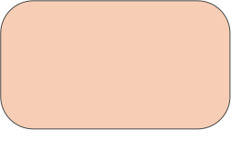
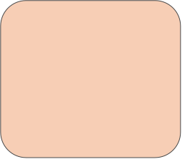
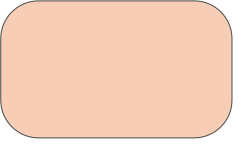

Methodology / Algorithms:
1. DATA COLLECTION
2. DATA PREPROCESSING
3. EXPLORATORY DATA ANALYSIS
4. MODEL TRAINING
5.MODEL EVALUATION
6.PREDICTION & RESULTS
ELECTION OUTCOME FORECASTING
RANDOM
FOREST CLASSIFIER
ELECTION RESULTS
(ECI)
CLEANING
BAR PLOT,HEATMAP,PIE PLOT,SOME ADVANCE PLOTTING
ACCURACY PRECISION
Recall
F1 SCORE
CANDIDATE AFFIDAVITS
(ADR/Myneta)
FEATURE ENGINEERING

Slide 5
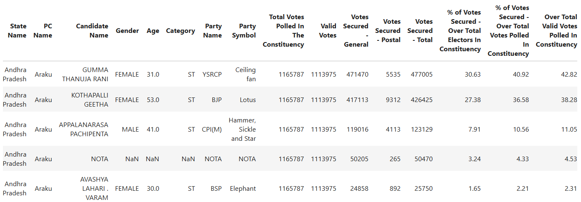
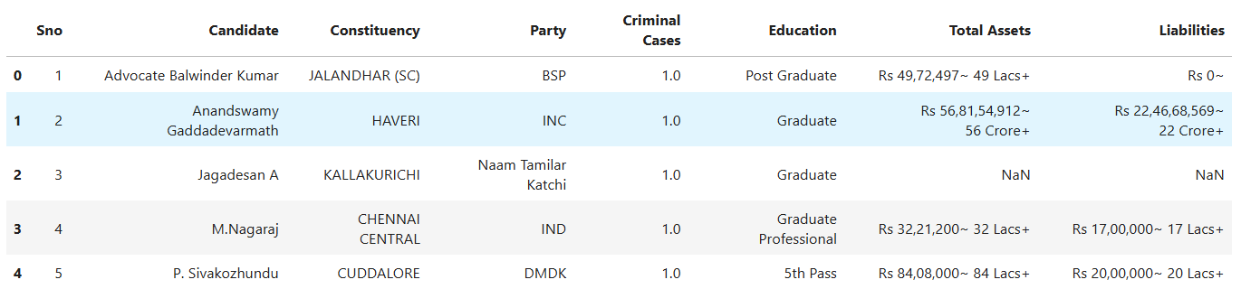
Data Collection :
Data Sources:
data.gov.in - Official 2024 election results and candidate information
Myneta.info - Electoral history, candidate profiles, and electoral analysis
Python-based web scraping implementation using BeautifulSoup library following ethical practices

Slide 6
2.Data Preprocessing:
5 Core Operations:
1. Convert Currency to Numerical
"Rs 49,72,497~ 49 Lacs+" → 4972497.0
2. Standardize Names
Candidate: Uppercase + trim spaces
Constituency: Remove (SC), (ST), (OBC) tags
3. Merge Datasets
Join on: Candidate Name + Constituency
4. Remove NOTA
Delete "NOTA" records (not a candidate)
5. Convert to Numerical
Age, Criminal, Votes → Int64
Assets, Liabilities → Float64
Winner → int (0/1)

Slide 7
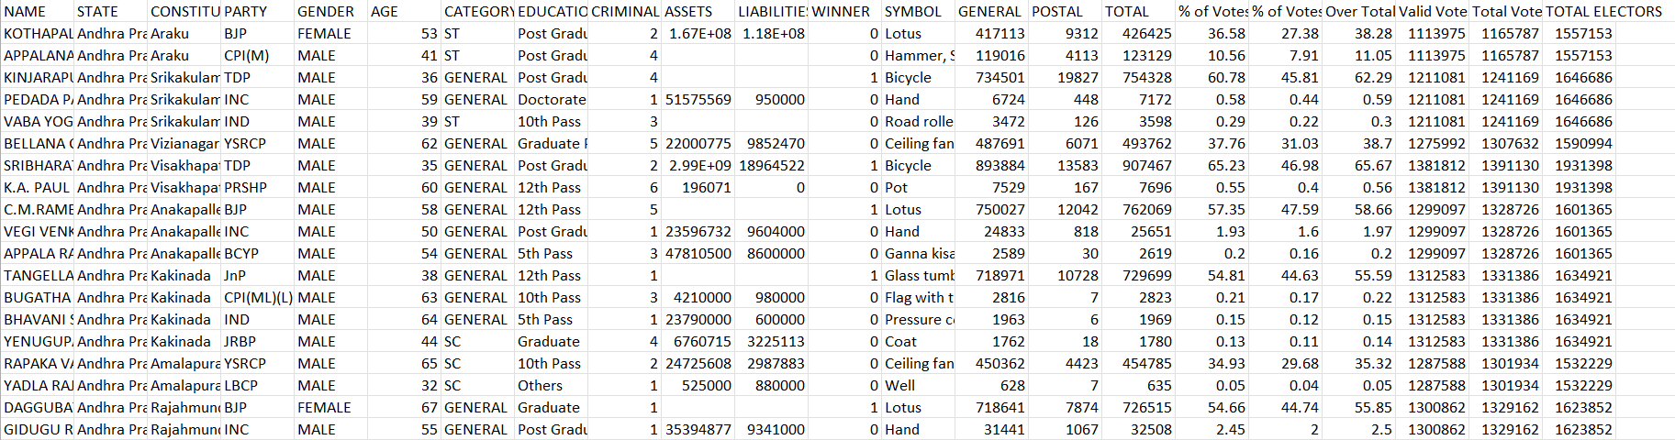
Final dataset :
1682 candidates × 22 features
All data types correct
Ready for EDA
Ready for ML modeling

Slide 8
3. EXPLORATORY DATA ANALYSIS(EDA)

Slide 9
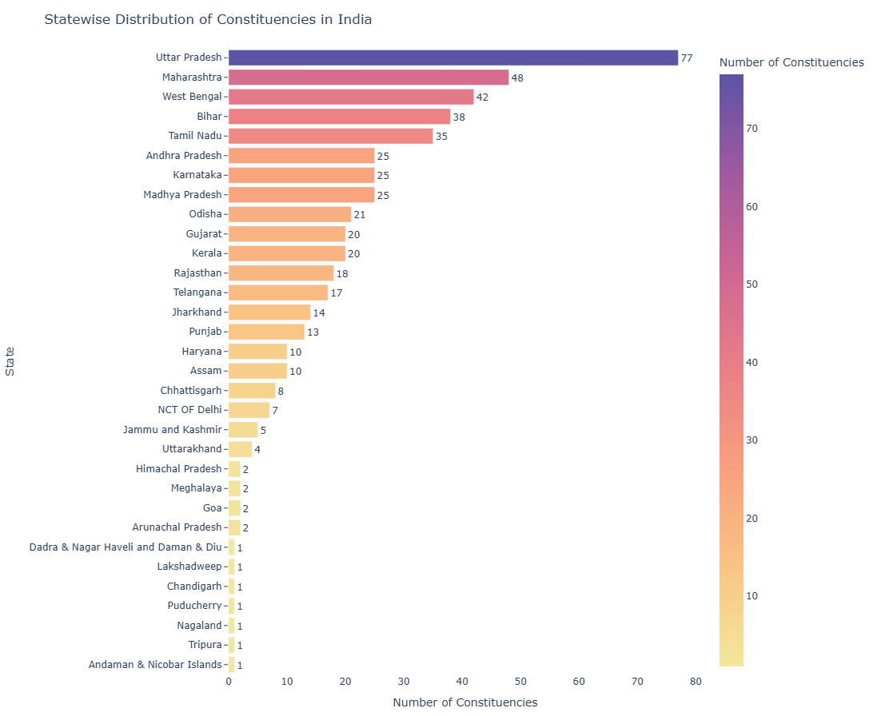
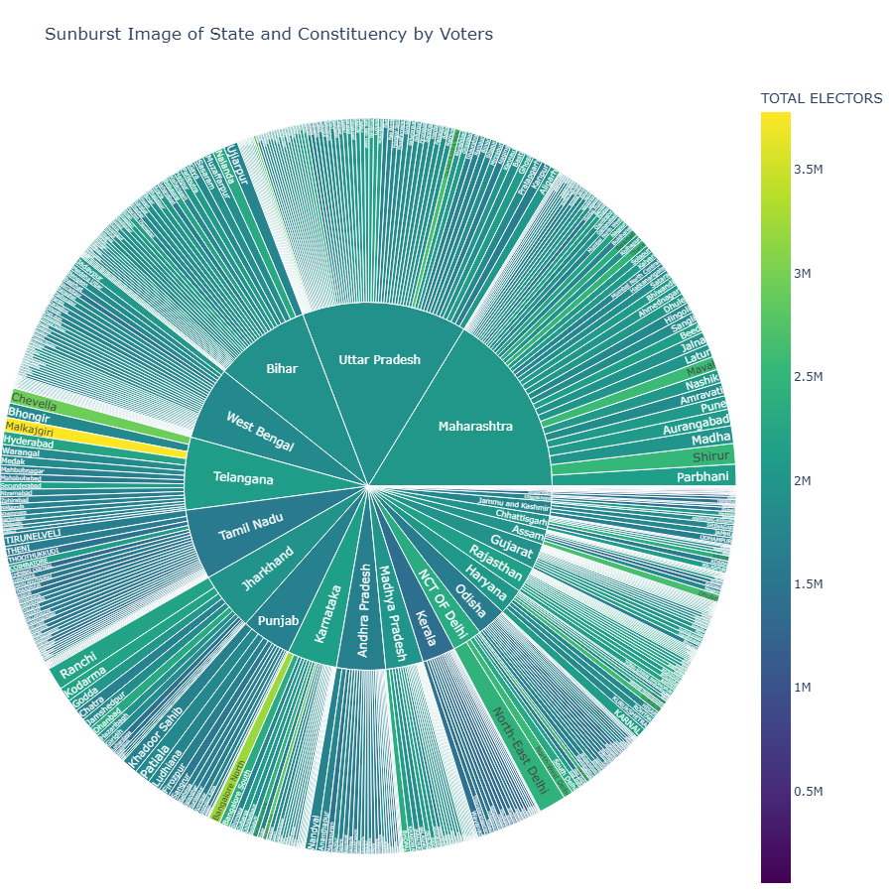
Observation:
UP leads with 77 seats, then Maharashtra 48, WB 42. Small states/UTs have 1–2 seats only.
UP, Maharashtra, and Bihar have most voters. Telangana seats (like Hyderabad) have high voters. Small states have few.

Slide 10
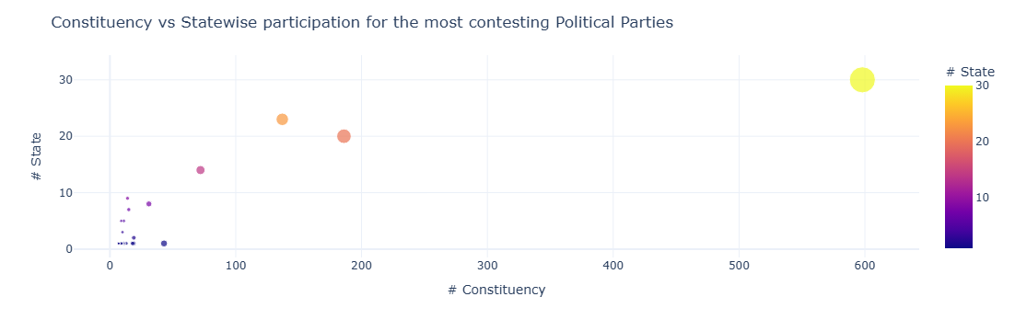
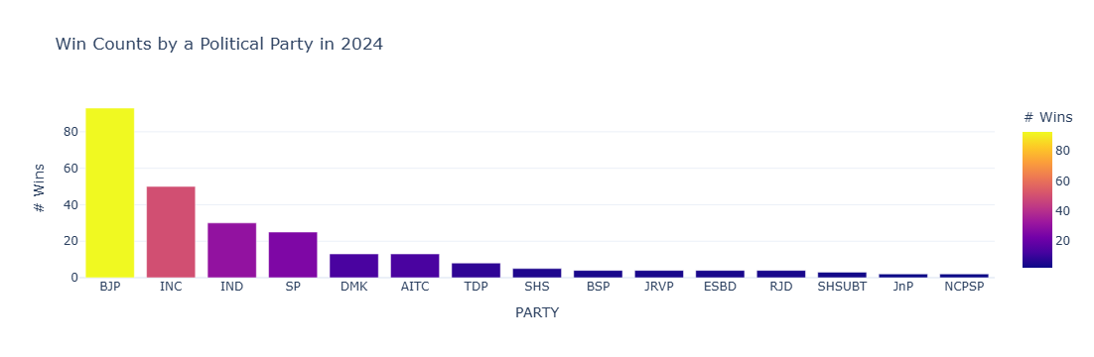
Observation:
BJP contested the most constituencies across nearly all states, showing the widest political reach.
Observation:
BJP secured the highest number of wins in 2024, followed by INC and IND, while all other parties won significantly fewer seats

Slide 11
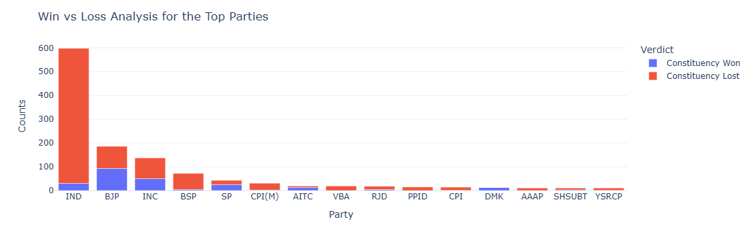
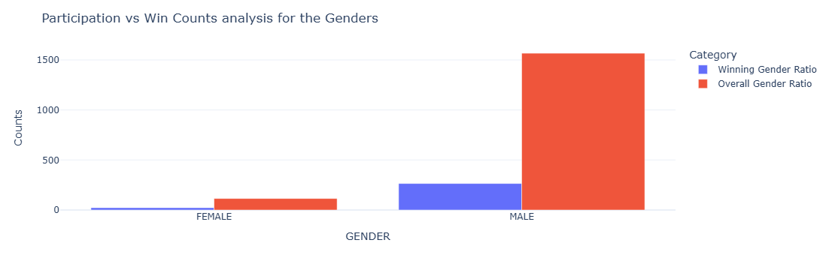
Observation:Independent candidates contested the most but had the highest losses, while BJP and INC achieved relatively better win ratios.
Observation: Male candidates show overwhelmingly higher participation and winning counts compared to females.

Slide 12
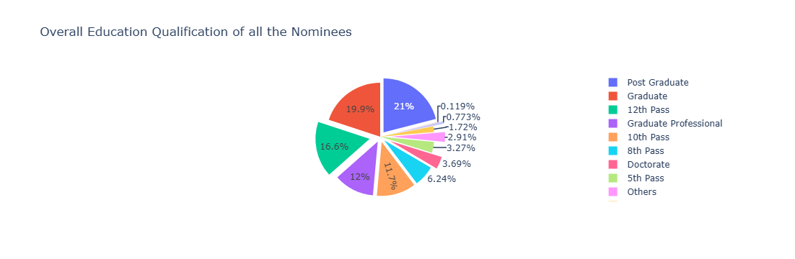
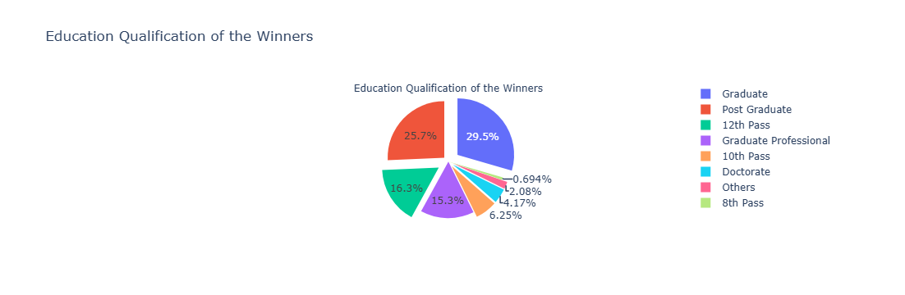
Observation: Most nominees and winners are graduates or postgraduates, but the proportion of higher-educated individuals (postgraduates and professionals) is slightly higher among winners, indicating education level positively influences electoral success.

Slide 13
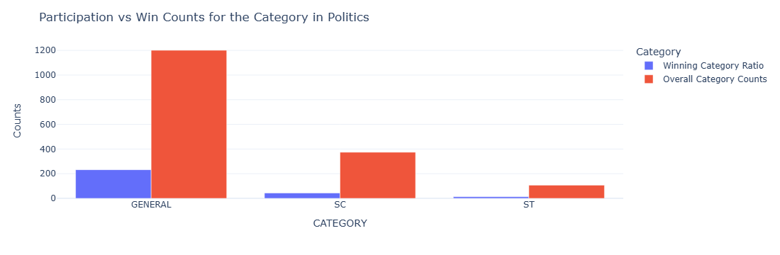
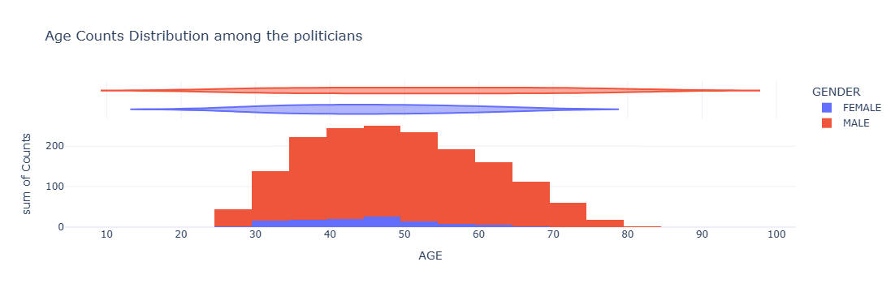
Observation: Candidates from the General category dominate both participation and win counts compared to SC and ST categories.
Observation: Majority of politicians fall between the ages of 40–60, with males significantly outnumbering females..

Slide 14
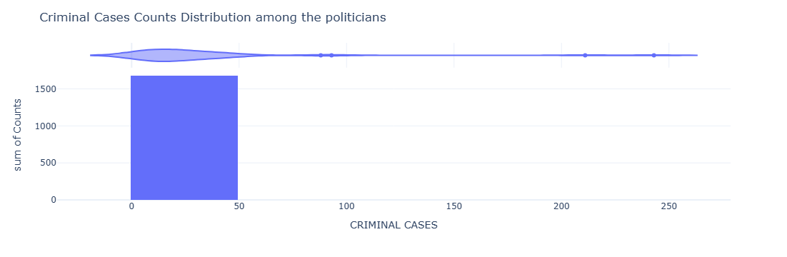
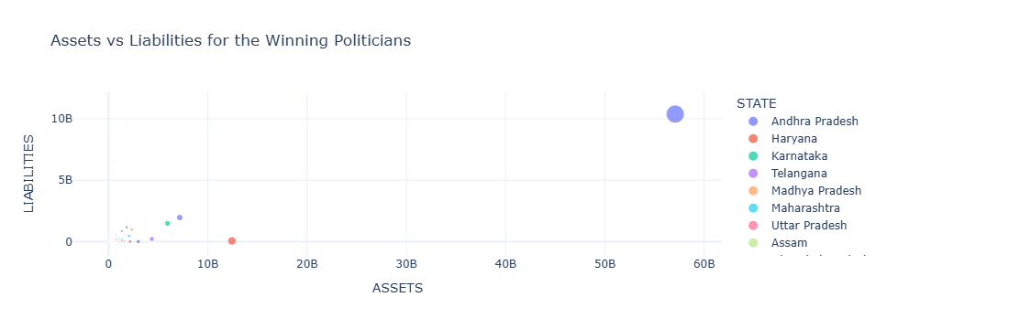
Observation: Many politicians have been associated with criminal activities. Always these cases pressed need not be genuine, but obviously, when its multiple- this is a serious issue. We must take the responsibility while voting, as its our duty to choose the right person- as a duty towards the nation.
Observation: Assets vs Liabilities Andhra Pradesh politicians show the highest assets and liabilities among all states.

Slide 15
4.Machine Learning Model
Model Training & Feature Preparation
Categorical encoding:
GENDER: MALE→1, FEMALE→2 (binary)
CATEGORY: GENERAL→1, SC→2, ST→3, OBC→4 (ordinal)
PARTY: 252 unique parties → encoded 1-252
EDUCATION: 12 education levels → encoded 1-12
Feature selection (14 features):STATE, CONSTITUENCY, PARTY, SYMBOL, GENDER, AGE, CATEGORY, EDUCATION, CRIMINAL CASES, TOTAL VOTES, TOTAL ELECTORS, ASSETS, LIABILITIES, WINNER
One-Hot Encoding: 14 → 600+ features
Feature scaling(Z-score normalization):
Result: All features have mean=0, std=1
Why: Equalizes feature importance, accelerates learning
Class imbalance handling (Oversampling):
Method: Random oversampling with replacement
Prepare X(Input) & y(target) for modeling

Slide 16
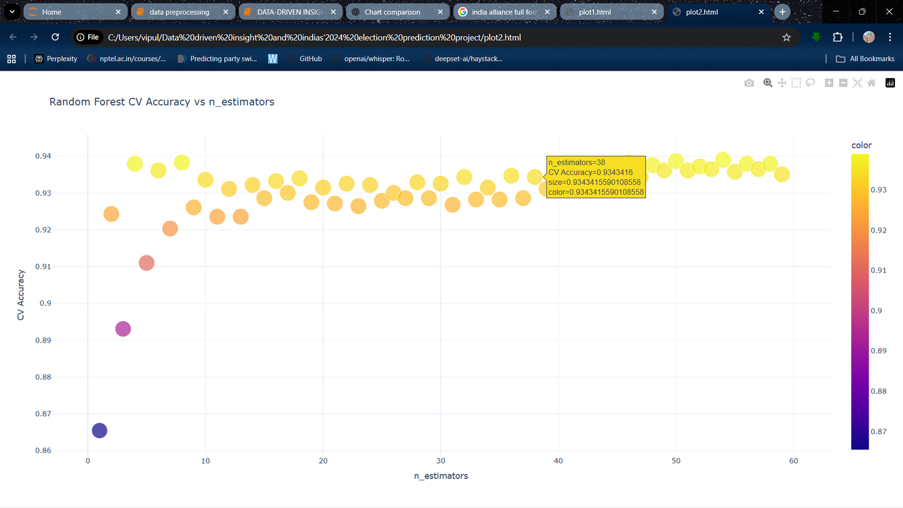
Hyperparameter Tuning:
Objective: Find optimal n_estimators
Tested: 1-59 trees via 10-fold cross-validation
Results: Accuracy plateaus at 30-40 trees
Selected: 38 trees (93.8% CV accuracy)
Why 38? Perfect balance, marginal gains beyond 40
Implications:
Model robustness with consistent generalization
Computational efficiency for production deployment
Reduced model complexity for faster inference
Model Configuration & Training:
Setup: 38 trees, random_state=0, parallel processing
Train-Test Split: 75% (2,091) training, 25% (697) testing
Stratified split maintains 50-50 class balance
Training process: 38 independent trees learning patterns

Slide 17
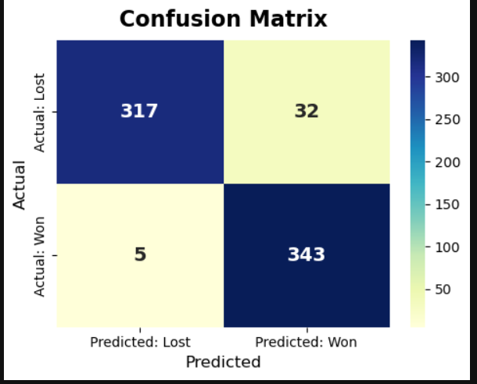
Generating Predictions:
Hard predictions: Binary 0 or 1 (majority vote from 38 trees)
Soft probabilities: 0.0-1.0 confidence levels (% trees voting winner)
Example: 32/38 trees → 84.2% probability of winning
Model Performance Evaluation:
Correct: 660 (94.69%)
Errors: 37 (5.31%)
FP: 32 (8.53% false alarms)
FN: 5 (1.44% miss rate)

Slide 18
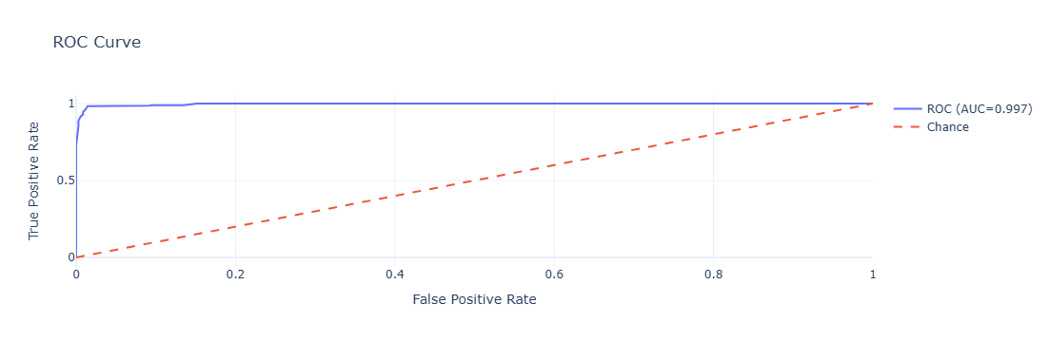
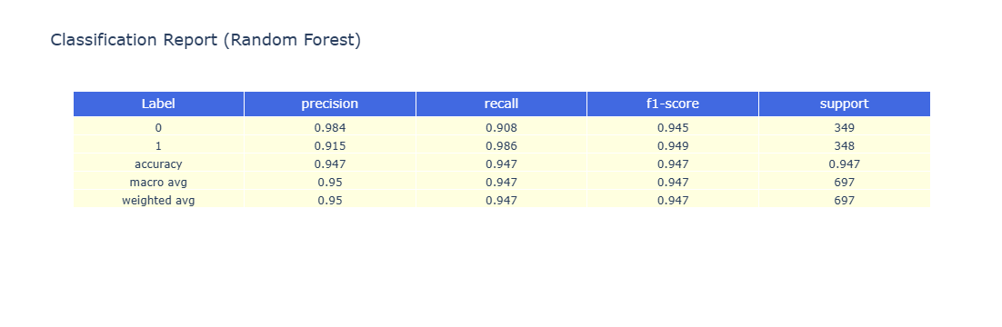
ROC-AUC (0.9969 = 99.69%) NEAR-PERFECT
Meaning: 99.69% probability model ranks random winner above random loser
AUC Benchmark: 0.95+ is near-perfect
Interpretation: Exceptional discrimination capability
KEY INSIGHT:
Model is excellent at:
Identifying losers (98.4% precision)
Catching winners (98.6% recall)
Overall accuracy (94.69%)

Slide 19
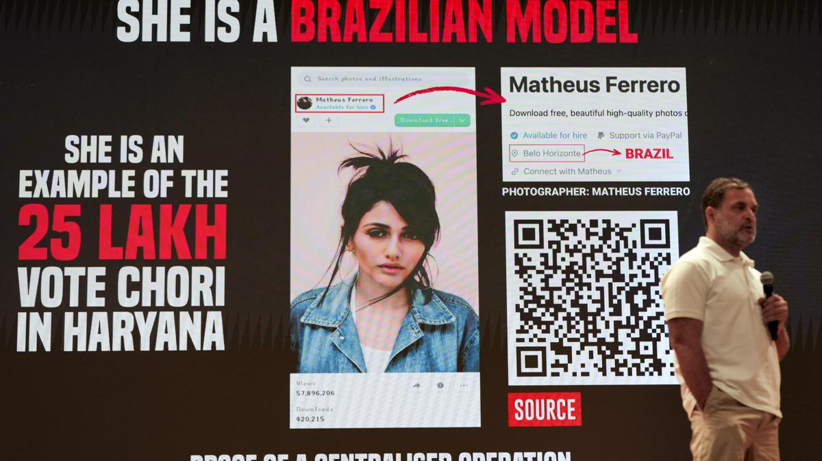
5.Future Work
Advanced Algorithm Comparison: XGBoost Implementation,LightGBM, Neural Networks, Support Vector Machines
Future Expansion:
1.Duplicate voter detection systems: Related to #VoteChori Allegations
2.Social media sentiment analysis integration.

Slide 20
6.Conclusions
Key Achievements:
✓Achieved 94.69% accuracy with Random Forest classifier
✓Exceptional ROC-AUC: 99.69% demonstrating superior discrimination
✓Excellent generalization: <1% performance gap between CV and test sets
✓Comprehensive EDA with 16+ visualizations identifying electoral patterns
✓Robust framework established for advanced algorithm testing
Github: github.com/Vipul-Ai-eng/DATA-DRIVEN-INSIGHTS-AND-PREDICTION-OF-INDIA-S-2024-ELECTIONS

Slide 21

Q&A
VOTE FOR DEVELOPMENT
VOTE FOR SAFETY
VOTE FOR EDUCATION
VOTE FOR FUTURE
VOTE FOR BETTER
INDIA
THANK YOU VERY MUCH!

